Slide 1
Debugging checks: Autoregressive masking MADE
The code for this can be found in the __main__ section of Output_layer.py

Slide 2
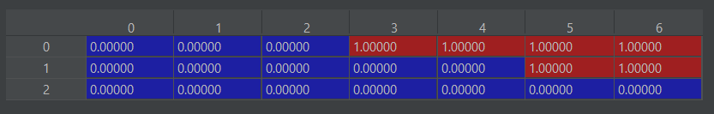

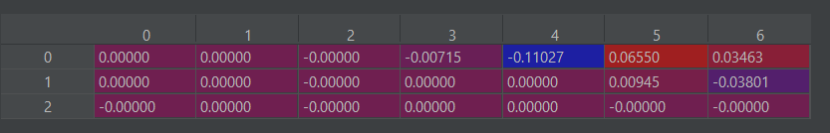

Input layer masking
Mask
z
Masked weight
n_nodes = 7
Matmul(z, masked_weight0

Slide 3
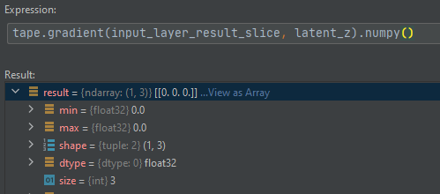
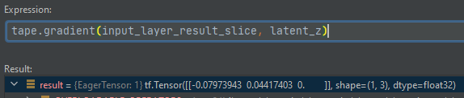
Input layer gradient check
d(output[0]/dz) (should be zeros)
d(output[-1]/dz) (should be non-zero for earlier elements)

Slide 4
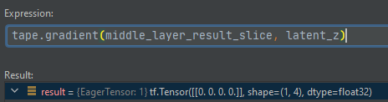
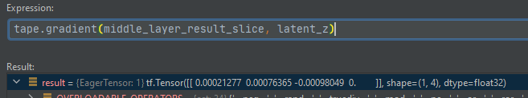
Middle layer
d(output[0]/dz) (should be zeros)
d(output[-1]/dz) (should be non-zero for earlier elements)

Slide 5
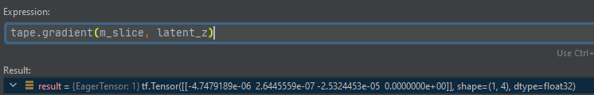
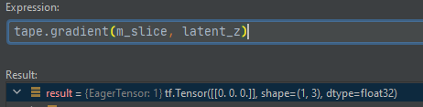
Output layer: Check autoregressiveness
dm[0]/dz
Should be 0s
d(m[-1]/dz) (should be non-zero for earlier elements)

